Slide 1

Module 43: Creating Business Rules
0/5
Siebel 8.0 Essentials
Notes:
Time: Lecture: <n – n> minutes; Labs: <n – n> minutes
Intent: <What is the instructional goal of the module>
Flow: < Describe at a high level the overall flow of the module>.
Key Terms: <List terms the instructor should be familiar with in order to teach this module>
<Term>
<Term>
<Term>
<Term>

Slide 2
Module Objectives
After completing this module you should be able to:
  Create rules using HaleyAuthority
  Deploy and administer rules in the Siebel client
  Invoke rules in the Siebel client
Why you need to know:
  You perform these steps to create business rules
Notes:
Each objective and “why you need to know” should be stated aloud.

Slide 3
Creating Siebel Business Rules
Concepts are generated in HaleyAuthority
  Are based on object definitions in the Siebel repository
  Are created by invoking the Siebel Object Importer
Statements are then written based on the concepts
  Rules developers must not:
    Modify the underlying concepts
    Create additional concepts manually

Slide 4
Developing Rules
0/4
1. Create a New Knowledge Base
2. Import Siebel Object Definitions
3. Create a Rule Module
4. Deploy the Rule Module
Notes:
This is a structuring slide for <insert what will be discussed>. Do not teach the steps or concepts here because the following slides cover them in detail. Provide a high level description of what will be discussed.

Slide 5
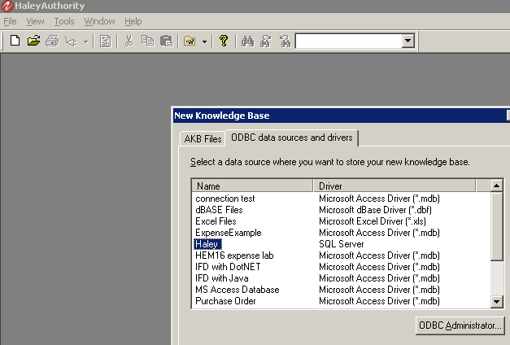
1. Create a New Knowledge Base
1/4
Start HaleyAuthority from the Siebel Tools program group
Select the ODBC connection string for the new knowledge base

Slide 6
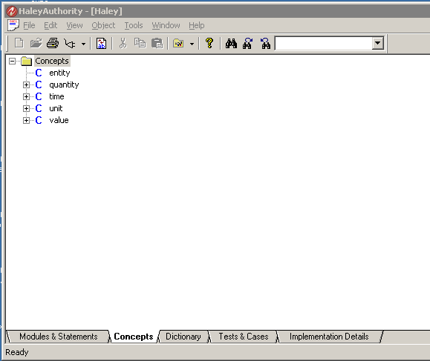
1. Create a New Knowledge Base Continued
1/4
Verify that a base set of Haley concepts appears
No entities yet

Slide 7
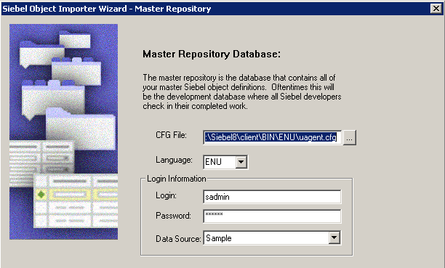
2. Import Siebel Object Definitions
2/4
Invoke the Siebel object importer
  In HaleyAuthority, select File > Import > Siebel Object
Provide the connection information for:
  Master repository data source (source of object definitions)
  Run-time data source (environment where rules will be run)
Example of configuration for importing from sample repository

Slide 8
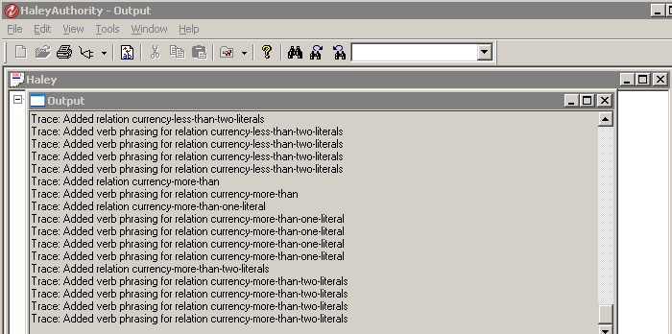
2. Import Siebel Object Definitions Continued
2/4
On the first import for a new knowledge base the following occurs immediately:
  Object definitions relating to currency and currency code are imported
  Concepts to support Siebel currency calculation procedures are created
  Siebel-specific actions, functions, and predicates are created

Slide 9
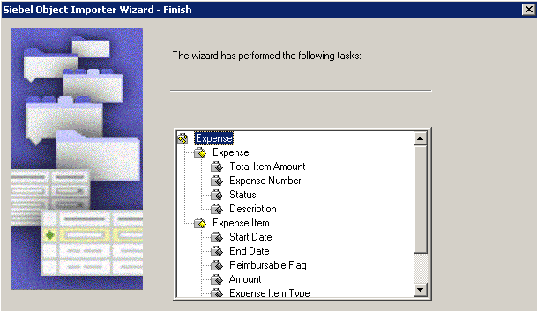
2. Import Siebel Object Definitions Continued
2/4
After currency-related concepts are created:
  Select Import Siebel Objects
  Specify the Siebel Business Object
  Select the business component and, possibly, child business components
  For each selected business component, select one or more fields
Business components and fields required for the expense report rules discussed in the previous module

Slide 10
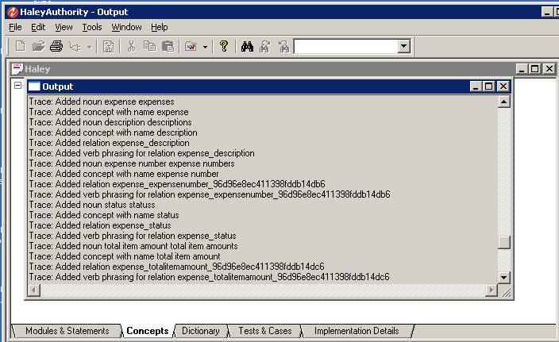
2. Inspect Concepts
2/4
Inspect the output window to verify that corresponding nouns, concepts, and phrasings were created

Slide 11
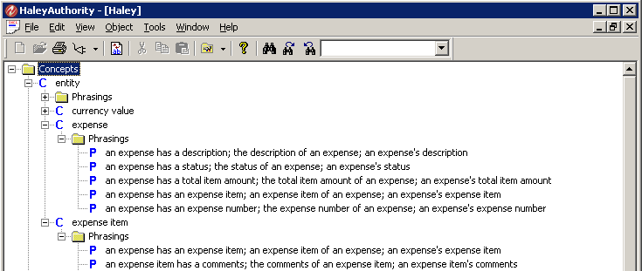
2. Inspect Concepts Continued
2/4
In the Concepts tab, expand entity and value
Verify that the entities and values corresponding to the objects and fields have been created
Inspect the phrasings
  Should be of the form “a <BusComp> has a <Field>” and equivalents

Slide 12
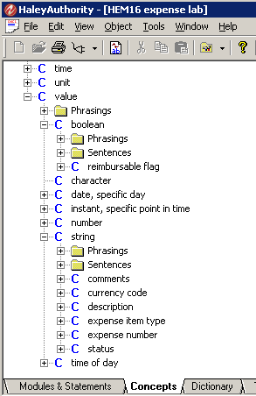
2. Import Siebel Object Definitions Continued
2/4
Additional import considerations
  Entities are used to represent business components
    Parent and child business components that are selected explicitly
    Business components that are referenced in multi-value fields
  Values are used to represent single-
  value fields
    Are categorized by the field type
      Example:
        DTYPE_TEXT → value: string
        DTYPE_PHONE → value: string
        DTYPE_INTEGER → value: number
  Several Siebel field types cannot be
  converted
    Are not displayed in the list of
    selectable fields

Slide 13
3. Create a Rule Module
3/4
A module is a collection of rule statements that are deployed together
  Suggestion:
    Create a rule module to contain only the statements that need to be evaluated as a set by the rules engine
    Name the rule module to indicate how the module will be invoked
A module can be divided into submodules to improve readability

Slide 14
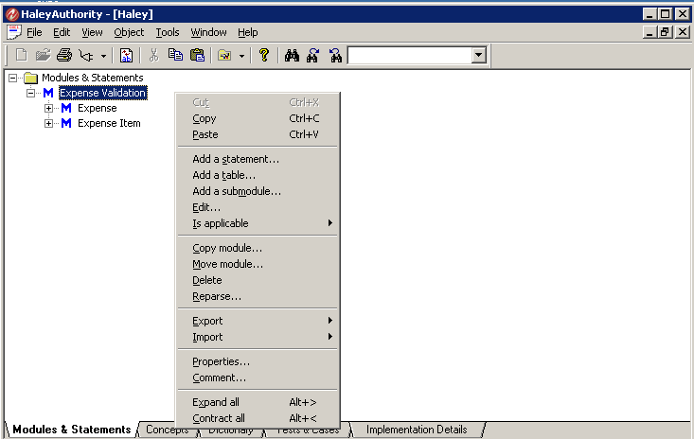
3. Create a Rule Module Continued
3/4
Click the Modules & Statement tab
Add a new module (and submodules if desired)
Module
Submodules

Slide 15
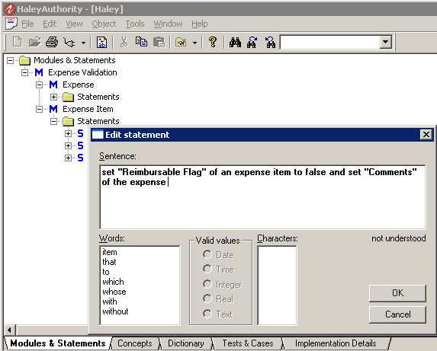
3. Create a Rule Module Continued
3/4
Add one or more statements
  Use the Edit Statement dialog box to enter the statement
    Text is bolded if it can be parsed, that is if the words entered correspond to defined concepts and phrases
    A list of eligible words is presented at all times
Enter text
Allowable words based on phrasings

Slide 16
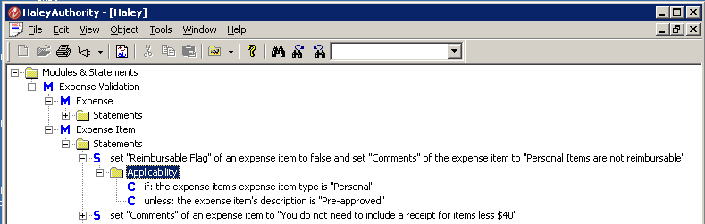
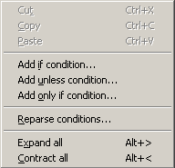
3. Create a Rule Module Continued
3/4
Add applicability conditions to specify when the statement applies
Edit statements until all content parses
Right-click Applicability to select condition

Slide 17
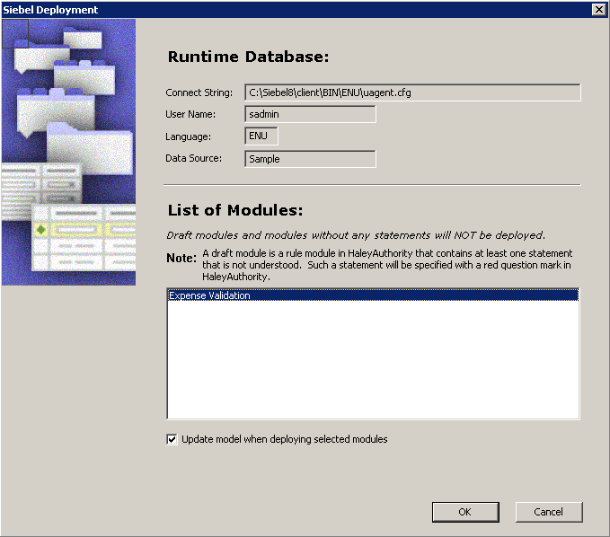
4. Deploy the Rule Module
4/4
Invoke the Siebel Deployer
  In HaleyAuthority select Tools > Siebel Deployment
  Verify the connection parameters for the run-time data source
  Select the modules to deploy and click OK

Slide 18
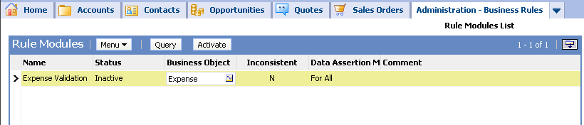
Administer Deployed Rules
In the Siebel client, navigate to Administration - Business Rules > Rule Modules List
Select the deployed rule module
Specify the business object that will provide data to the run-time rules engine
  Should be the business object specified for object import

Slide 19
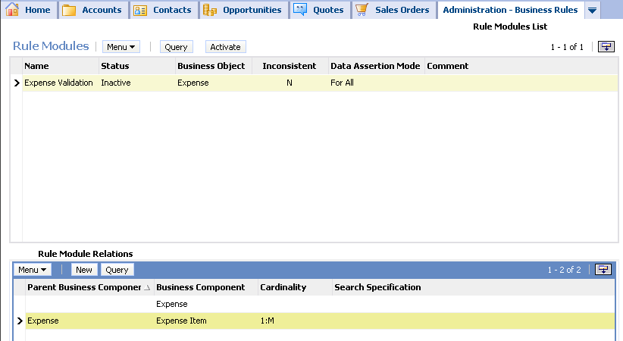
Administer Deployed Rules Continued
Create one or more Rule Module Relation records
  They identify the business components necessary to evaluate the rules
Click New and select the records that specify the parent-child relationships captured in the rules

Slide 20
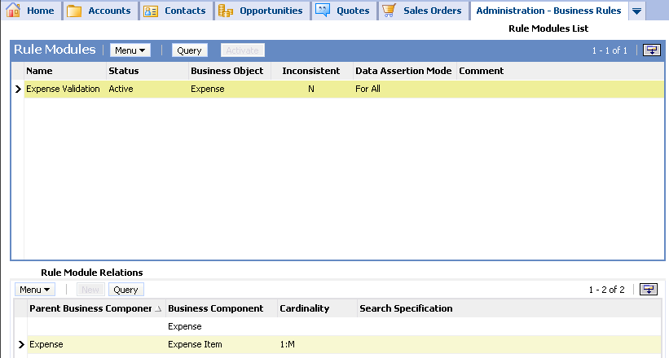
Activate Rules
Click the Activate button in the Rule Modules list applet to set the status to active
  Only active rules are evaluated by the rules engine
Status changes to Active

Slide 21
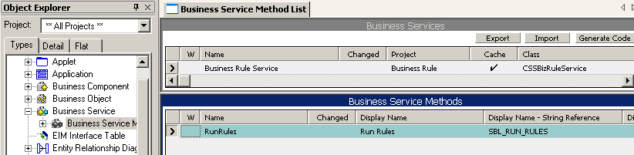
Invoking the Rules Engine
The rules engine is accessed by calling the Business Rule Service business service
  Can be invoked using an action set for a run-time event

Slide 22
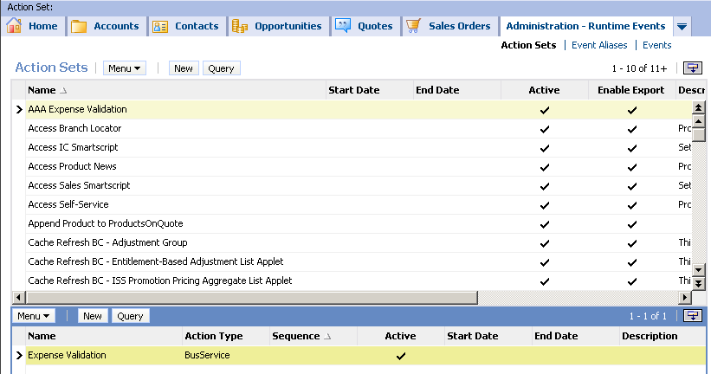
Creating a Run-Time Event Action Set
In the Siebel client, navigate to Administration - Runtime Events > Action Sets
Create a new action set, and a child action of BusService type
Action set
Action for the action set

Slide 23
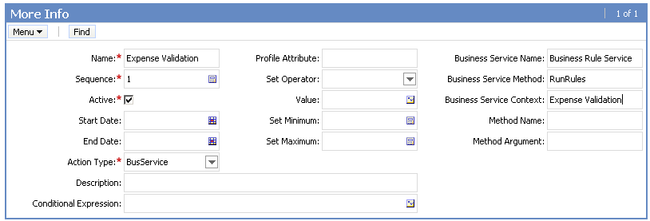
Creating a Run-Time Event Action Set Continued
In the More Info applet
  Specify Business Rule Service and RunRules as the business service name and method
  Specify the rule module name as the context

Slide 24
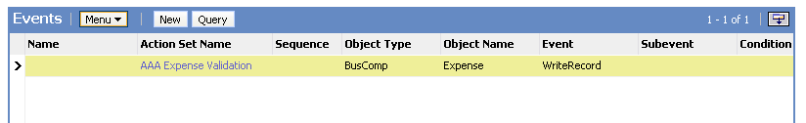
Creating a Run-Time Event Action Set Continued
Navigate to Administration - Runtime Events > Events
Create an event record for the business component
  Specify the desired run-time event
  Assign the action set
Select Reload Runtime Events from the applet menu
Action set
Run-time event

Slide 25
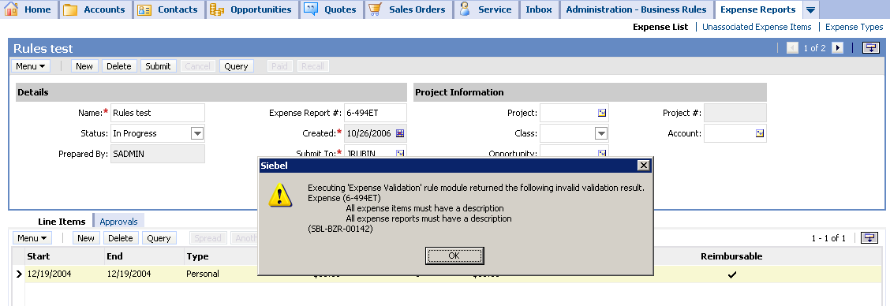
Test the Rule Module
Create a record and trigger the run-time event
  Verify that the desired business logic is executed
Create additional records as required to fully test the rules

Slide 26
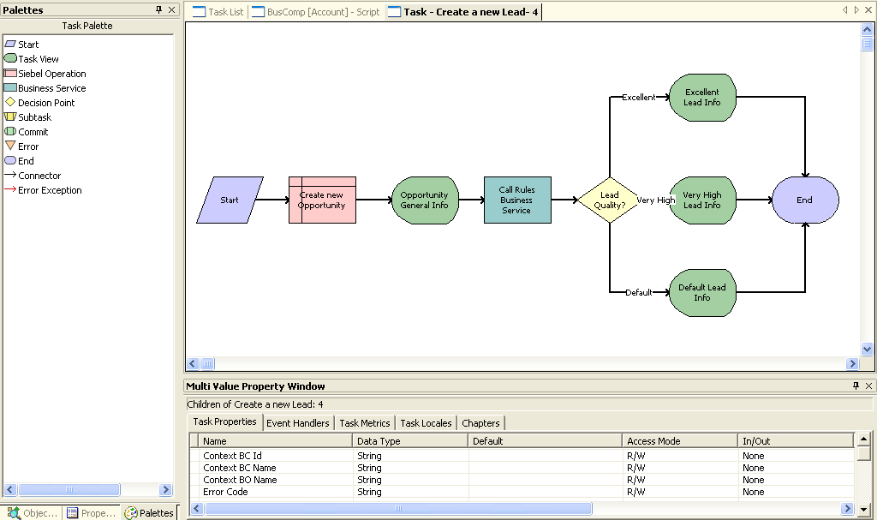
Additional Ways to Invoke the Rules Engine
The business rules service can be invoked:
  In custom scripts
  In business service steps in Siebel workflows and tasks
Invokes rules engine to determine the lead quality

Slide 27
Module Highlights
Create rules by:
  Creating concepts by importing business components and fields from the Siebel repository
  Building statements based on the concepts
Deploy the rules module to the Siebel run-time client
Activate the rules in the client
Invoke the rules by using a run-time event
    Configure an action set
Notes:
Review Question: <Question>
Answer: <Answer>

Slide 28
Lab
In the lab you will:
  Create a new rule
    Import a set of Siebel objects
    Create the rule module
    Deploy and administer the module
    Create an action set triggered by a run-time event
Notes:
Labs and Troubleshooting:
<Summarize the tasks the students will perform in this lab. Suggest specific guidance the instructor may provide if necessary to help the students complete the lab and avoid trouble spots.>

